Slide 1


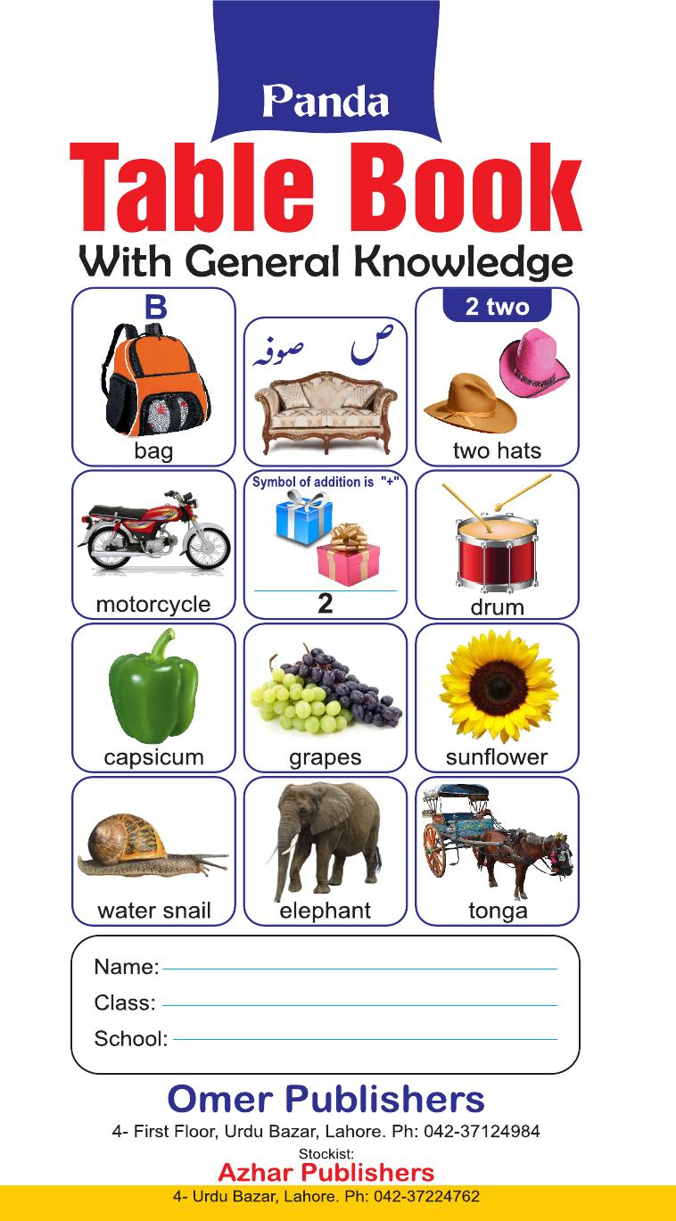
Panda Table Book
Playgroup • Age 3+
An activity-based early-years book from the Panda Series.
A Project of Azhar Publishers & Book Factory

Slide 2
i
What's Inside
Panda Table Book Playgroup • Age 3+
1
English and Urdu alphabets
2
Counting 1 to 100 in figures and words
3
Multiplication tables from 1 to 20
4
Roman numerals, measures and types of numbers
5
Colours, shapes, addition and subtraction
6
Flags, birds, animals, transport and more

Slide 3
★
Purpose & Classroom Support
A handy all-in-one reference — alphabets, counting, tables, measures and themed vocabulary — that children can return to again and again.
“
Every book comes with
1
2
3
Teacher's Lesson Plan
Practice Papers
Digital Interactive Version
A 40-week lesson plan that guides teachers, day by day.
Monthly tests and term exam papers for children to attempt.
An interactive flipbook and digital exercises for engaging, screen-based practice.
A Project of Azhar Publishers & Book Factory

